Slide 1
OWASP top10

Slide 2
A1.Broken Access Control
It is like an unauthorized user are allowed to perform actions beyond their permission.
Least Privilege
Bypassing Access Control
IDOR (Insecure Direct Object Reference)
Missing Access Control in APIs
Privilege Escalation / Token Manipulation
Force Browsing
CORS Misconfiguration

Slide 3
A2.CRYPTOGRAPHIC FAILURES
It means “insecure handling of sensitive data” When the sensitive information are leaked because of
1)lack of encryption
2)or the cryptographic functions or tools are not used properly
Lack of Encryption
Use of Weak or Old Algorithms
Certificate Validation Issues
Weak Password Management
Improper Token Generation
No Encryption at Rest

Slide 4
A3.Injection
It happens when an application takes untrusted input (data from users or other sources) and directly uses it inside commands or queries without proper checks or protections.
User Input Not Validated or Sanitized
Dynamic Queries with Concatenation
No Use of Parameterized Queries
Hostile Data in ORM Tools
No Escaping of Special Characters

Slide 5
A4.Insecure Design
It refers to missing or weak security controls that should have been part of the initial architecture or planning phase.
Abuse of Business Logic
Insecure Workflow
Lack of Anti-Bot Measures
Privilege Escalation
Resource Abuse

Slide 6
A5.Security Misconfiguration
Security Misconfiguration means not properly setting up security controls in applications, servers, or databases. This can expose sensitive data or allow attackers to exploit the system easily.
Unnecessary Features Enabled
Default Accounts and Passwords
Detailed Error Messages Shown
Missing or Weak Security Headers
Outdated or Vulnerable Software
Upgrades Without New Security Features
Insecure Framework or Database Settings

Slide 7
A6.Vulnerable and Outdated Components
Vulnerable and Outdated Components means using software that are old, unpatched, or have known security flaws making it easy for attackers to exploit them.
Use of Old or Unpatched Software
Not Checking for Known Issues
Delayed Patching
No Testing After Updates

Slide 8
A7.Identification and Authentication Failures
This vulnerability happens when the system doesn't properly verify the user’s identity or manage their login session securely.
Brute Force Possible
Default or Weak Passwords Allowed
Insecure Password Storage
No Multi-Factor Authentication
Session ID in URL
Session Fixation
Sessions Not Logged Out Properly

Slide 9
A8.Software and Data Integrity Failures
Software and data integrity failures happen when an app trusts files, code, or data without checking if they are safe. Attackers can change or replace them and make the app run harmful code.
Using Code from Untrusted Sources
Developers rely on libraries or modules (e.g., from GitHub, npm, Maven, or CDNs) without checking if they’re safe.
Auto-Updates Without Integrity Checks
Some apps download and install updates automatically without verifying their source or contents.

Slide 10
A9.Security Logging and Monitoring Failures
Security Logging and Monitoring Failures happen when an application doesn’t properly keep track of important events — like login attempts, suspicious actions, system errors
Important Events Not Logged
Such as- Timestamps ,user identifiers, IP addresses, Request source, actions (“login failed”, “password changed),results(success/failures)
Logs Stored Only Locally
Without capturing these events, it is impossible to track user activity, and to check the malicious activity.

Slide 11
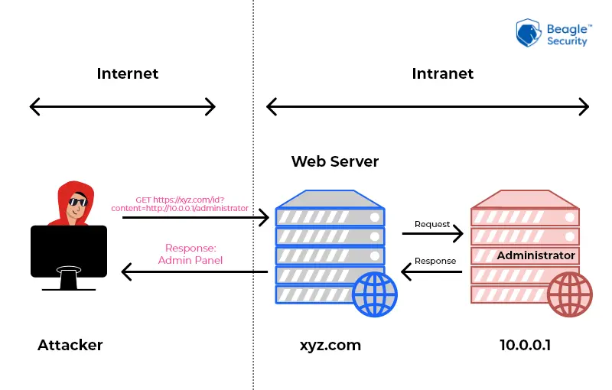
A10.SERVER-SIDE REQUEST FORGERY(SSRF)
SSRF happens when an attacker tricks a server into making requests to internal or external systems, often bypassing firewalls or network restrictions.
Attackers can abuse this to access sensitive data, internal services, or perform unauthorized actions.
Bypassing Firewalls and Network Restrictions
Accessing Internal Services
Abuse of URL Parameters
Fetching Sensitive Data from Internal Systems
Triggering Unauthorized Actions via Server Requests

